Slide 1
MORE Updates
Making
Opportunities
Real
for
Everyone
In the Rock and Mississippi River Regions
A 60 by 25 Leadership community

Slide 2
Making Opportunities Real for everyone (MORE) in the Rock and Mississippi River Regions:
A 60 by 25 Leadership Community
Making Opportunities Real for Everyone- MORE
Our Region: Dixon to Clinton, IA
Current Partners/benefactors: Sauk, Morrison Tech, NIU P-20 Center, WACC-18 area HS, ROE 47, CGH Sterling, Sauk Valley Chamber, Morrison Chamber, Fulton Chamber, Clinton Economic Regional Development Corp., and we hope to expand and include you.
Keep talent local while helping students and businesses connect through opportunities

Slide 3
Goals
Purchase and implement Career Cruising Inspire- Will be setting up for fall usage 18 WACC schools
Promote-support the Sauk Multi-craft initiative
Promote-support Morrison Tech Pre-engineering
Support NIU, Sauk and WACC efforts to increase enrollment in health-science field
Build capacity in schools to partner with businesses PreK-12 grade

Slide 4
60 by 25 support
IL 60 by 25 supports leadership communities- Extending the work of the NIU P-20 council
Grant opportunities
  A-Remedial math programing- $5000.00
  B- College and Career endorsements on HS graduation diploma. $5000.00
  C- Career Pathway planning and completion
Technical support- Offer training on and off site
Financial support through sponsorship of activities

Slide 5
Career Cruising Inspire
Keeping our resources local through personal work relationships
Making Opportunities Real for everyone in the Rock and Mississippi River Regions- MORE

Slide 6
Area Partners
Whiteside Area Career Center
WACC High Schools
Sauk Valley Community College
Regional Office of Education 47
Sauk Valley Chamber of Commerce
Morrison Chamber of Commerce
Fulton Chamber of Commerce
Clinton Regional Development Corp.
Morrison Tech.
Blackhawk Hills Regional Council
CGH Hospital Sterling, IL.
Northern IL. University P-20 Center
Need=Area businesses

Slide 7
Keeping Talent Local
Existing jobs in our area go unfilled
Area students are not aware of the openings
Area businesses need to develop a talent pipeline
Middle and High School students are potential candidates
Career Cruising Inspire connects students to opportunities

Slide 8
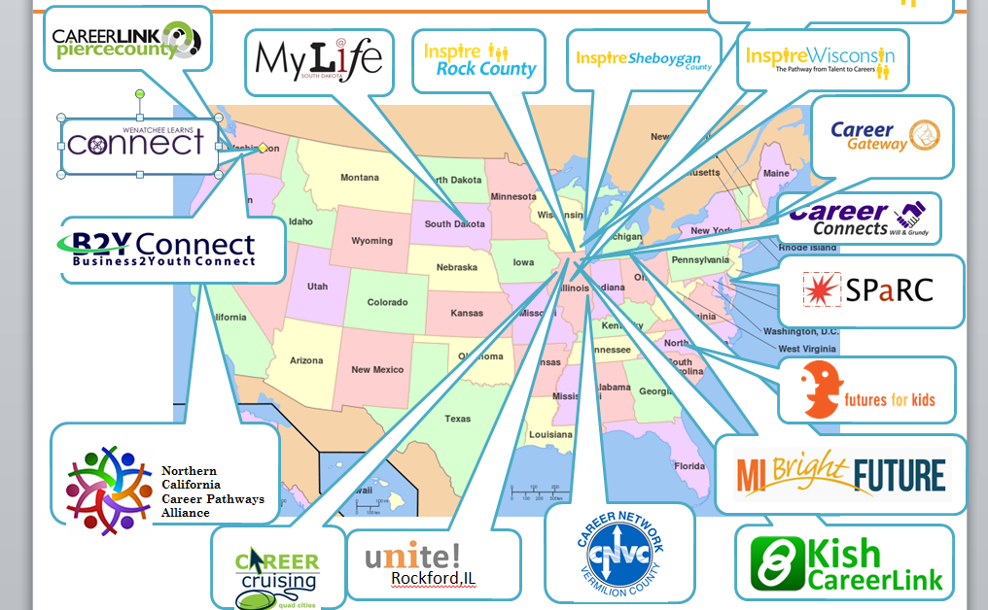
Proven Platform

Slide 9
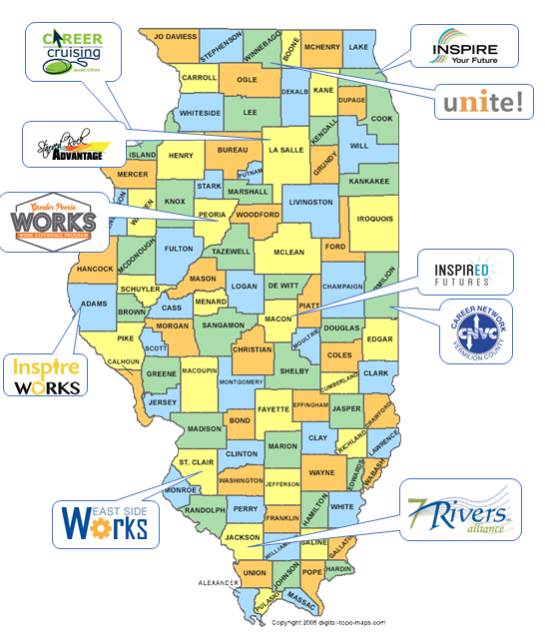
Illinois Programs

Slide 10
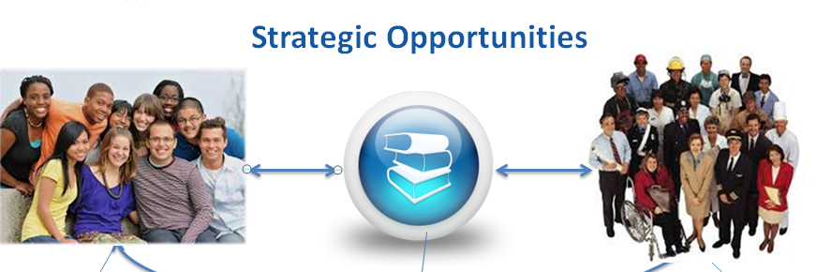
For Kids For Employers

Slide 11
Win-Win for ALL Involved
Employers:
Increase your business’s visibility and highlight your community involvement
Promote careers and help students realize the opportunities in their hometowns
Promote company internships and apprenticeship opportunities
Make our region into a strong workforce and economically vibrant area
Easy to register, Easy to participate

Slide 12
Win-Win for ALL
Schools
-Educators, students and parents can connect efficiently with
companies and real life professionals in career fields.
-Learn about companies that offer jobs and
careers in manufacturing, technology, business,
medical fields, engineering and many others.
- Participate in career discussions with an
online mentor/coach from your chosen field.
- Further interact with the company by participating in other
worked-based programs like shadowing, internships, tours
and summer employment

Slide 13
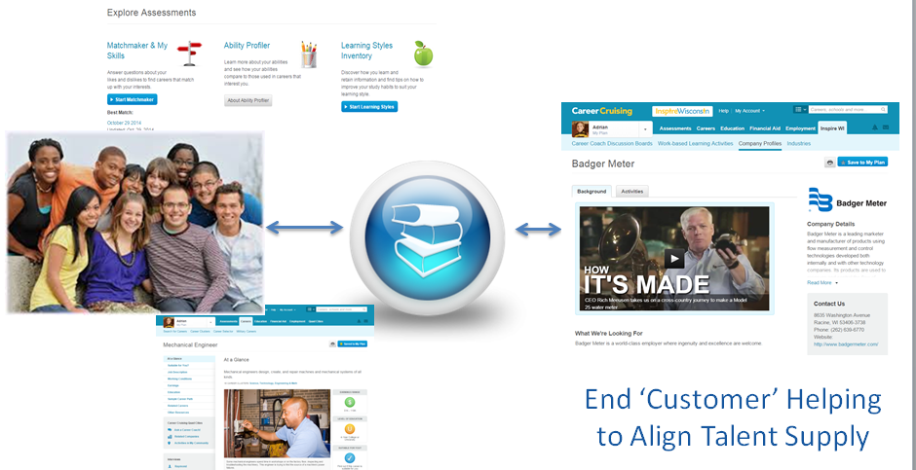
Aligning workforce needs with our talent pipeline

Slide 14
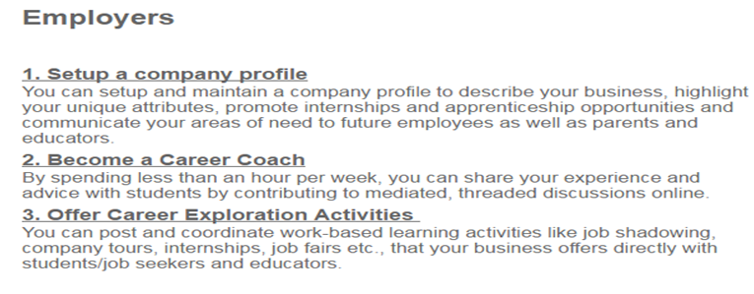
Employer Participation

Slide 15
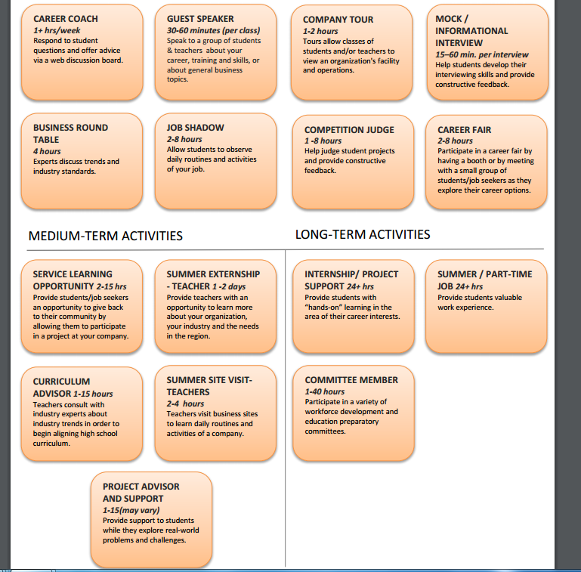
Select participation that works best for your business

Slide 16
Inspire Sheyboygan

Slide 17
Talent Pipeline
WACC Students Bureau Valley HS
Fulton HS Oregon HS
Morison HS Amboy HS
Sterling HS Ohio HS
Rock Falls HS Dixon HS
Eastland HS Polo HS
Prophetstown HS AFC HS
Erie HS Milledgeville HS
Sterling-Newman HS Unity Christian HS
Faith Christian HS

Slide 18
Supporting Businesses
*If you have job openings
*If you have an aging workforce
*If you want to keep talent local
*If you want to impact our region
*If you want to market your business
Then we need you to enroll

Slide 19
Timeline
-Gather Business interest-January/February 2017
-Purchase and set-up software-Feb./March 2017
-Enroll Businesses- Starting Feb or March 2017
- Conduct Inspire seminar with Administrator, counselor and staff from 18 WACC HS- June 2017
-Instruct students and begin partnership activities 2017-18 school year.

Slide 20
Initial Goals
40 area businesses enrolled by August 2017
35 job coaches enlisted to assist
50 job activities available for students
HS counselors and staff trained to share with students by August 2017
Continue to enlist businesses

Slide 21
We need you
To Enroll:
Please complete the interest form and you will
be contacted when the website is active
We look forward to working with your business and keeping our talent local

